Slide 1
Lecture 9 – Logistic Regression (Part 2)
Instructor: Hamed Hasheminia

Slide 2
Agenda
Unbalanced observations and Logistic Regression
FP/FN/TP/TN/FPR/TPR/FNR
The effect of changing Threshold
ROC curves
Area Under Curve
How to compare classification algorithms

Slide 3
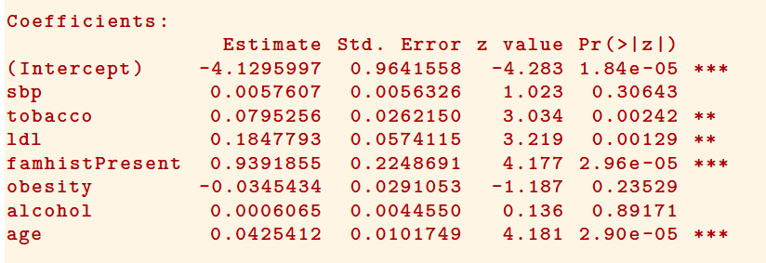
Quiz - How do we interpret this?

Slide 4
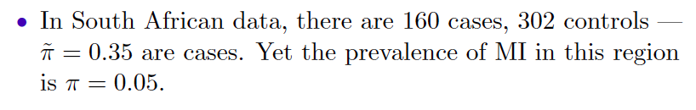
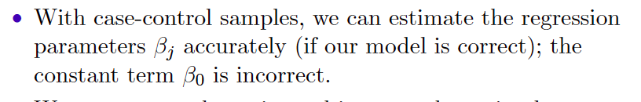
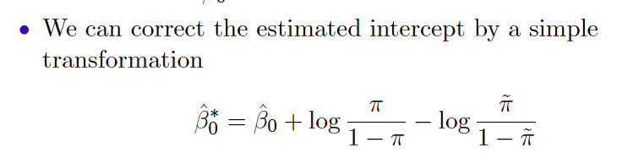
Case-Control Sampling and Logistic Regression

Slide 5
Credit Data
 |  | Predicted Default Status
 |  | No | Yes | Total
True Default Status | No | 9644 | 23 | 9667
 | Yes | 252 | 81 | 333
 | Total | 9896 | 104 | 10000
(23 + 252)/10000 errors – a 2.75% misclassification rate! Is it good?
Some caveats
This is training error, and we may be over-fitting. But this is not a big concern in this case since n = 10000 and we only used 4 parameters.
If we classify everything as No – then we make only 3.33% error.
Of the true No’s, we make 23/9667 = 0.2% errors; of the true Yes’s, we make 252/333 = 75.7% errors!

Slide 6
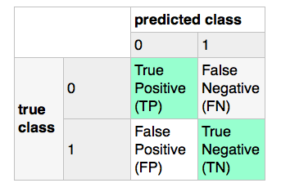
TP/FP/FN/TN

Slide 7
Error / Accuracy / False Positive Rate / True Positive Rate / Precision / Recall
ERR = (FP + FN) / (FP + FN + TP + TN)
ACC = (TP + TN)/ (FP + FN + TP + TN) = 1 – ERR
False Positive Rate (FPR)
FPR = FP / (Total Negatives) = FP / (FP + TN)
True Positive Rate (TPR) – Also Called Recall
TPR = TP / (Total Positives) = TP / (TP + FN)
False Negative Rate
FNR = FN / (Total Positives) = FN / (TP + FN) = 1 - TPR
Precision (PRE)
PRE = TP / (TP + FP)

Slide 8
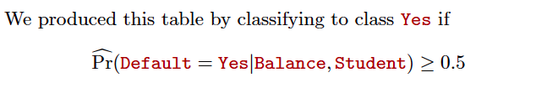
Credit Data - continues
 |  | Predicted Default Status
 |  | No | Yes | Total
True Default Status | No | 9644 | 23 | 9667
 | Yes | 252 | 81 | 333
 | Total | 9896 | 104 | 10000
False Positive Rate = 252/333 = 75.6%
(From those who did default 75.6% mistakenly predicted that they would not default)
True Positive Rate = 9644/9667 = 99.76%
False Negative Rate = 23 / 9667 = 0.24%
(From Those who did not default, only 0.24% were mistakenly predicted to default.)

Slide 9
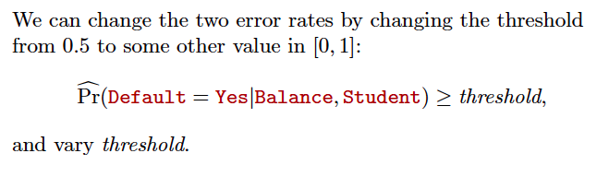
Changing Threshold

Slide 10
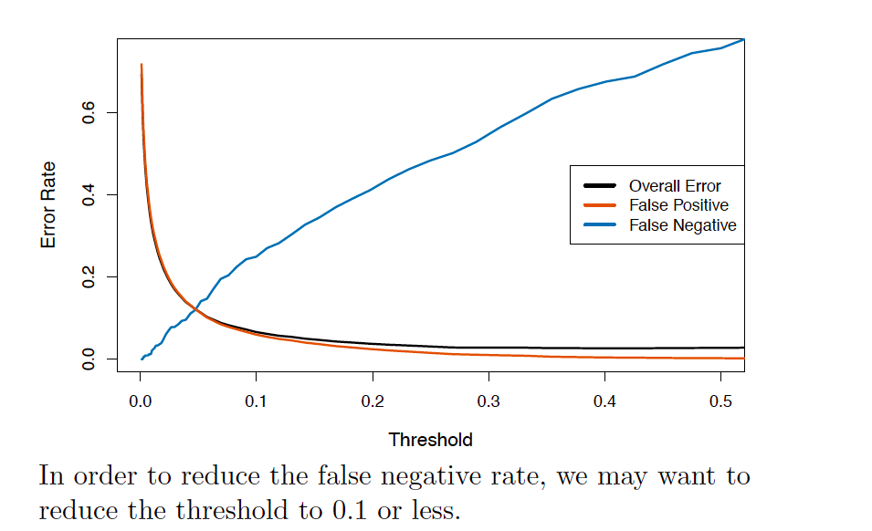
Varying the Threshold

Slide 11
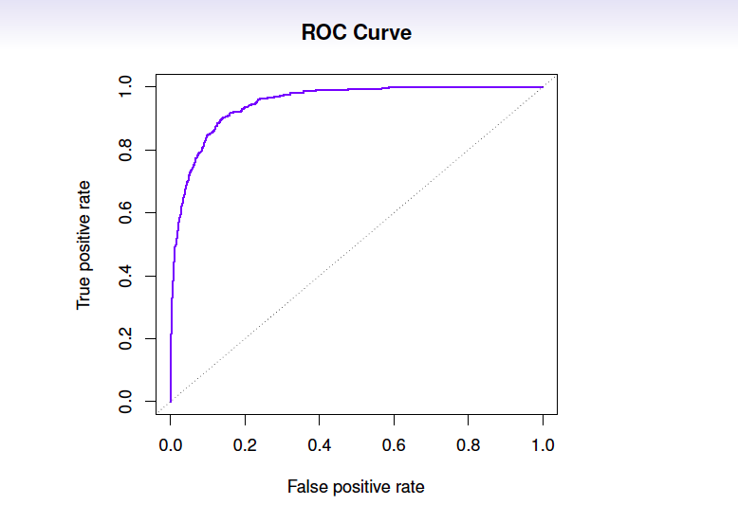
ROC Curve

Slide 12
Let’s explore ROC
http://www.navan.name/roc/
After Instructor’s instructions please team-up with with another student and explain ROC to each other.

Slide 13
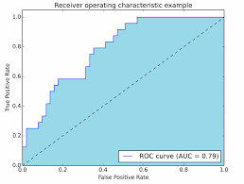
Area Under Curve (AUC)
One of the measures used to evaluate Classification Algorithms is Area Under Cure (AUC) of ROC.
Usually the model which has the largest AUC is considered the best classification model.
AUC is a number between (0.5 and 1). Why couldn’t it be less than 0.5?

Slide 14
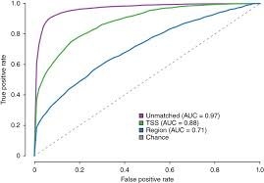
Which Classification Model is better?

Slide 15
Summary
How to adjust Logistic Regression coefficients for unbalanced data
FP/FN/TP/TN/FPR/TPR
How changing Threshold can change FPR/TPR/FNR/TNR
What ROC curves mean
How to calculate Area Under Curve
How to compare classification algorithms using AUC

